Slide 1
Netball
RULES & TECHNIQUES OF GAMES
SEMESTER III
B.S HEALTH &PHYSICAL EDUCATION
LCWU

Slide 2
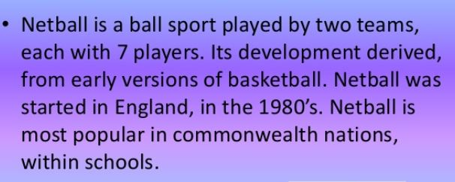
Netball

Slide 5
Where is netball played?
Netball is enjoyed in over 70 countries and by more than 20 million people worldwide. In 1995 it became a recognized Olympic sport and three years later, was played in the Commonwealth Games at Kuala Lumpur. Netball competition is also a part of the 2018 Commonwealth Games in Gold Coast, Australia.

Slide 6
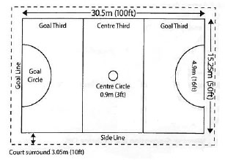
The Netball Court

Slide 7
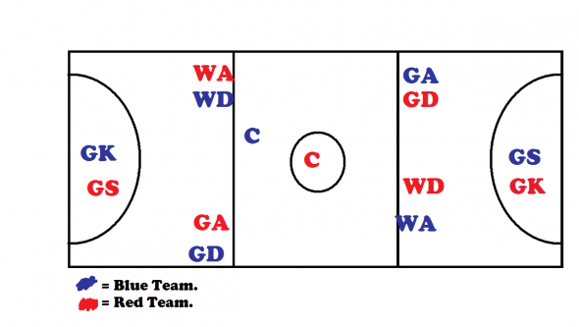
Where to Stand?

Slide 8
C-Center: Allowed to run the whole court except for the goal circles.
WA-Wing Attack: Middle: Center and your goals third except for the goal circle.
WD-Wing Defense: No goal circle. Center half and both thirds.
GD-Goal Defense: Opponents goal circle, third and Center. Not your goal circle nor your third.
GA-Goal Attack: Your goal circle, third and center. No oppenents goal circle.
GS-Goal Shooter: Your goal circle and third. No opponents goal circle, third and center.
GK-Goal Keeper: Opponents goal circle and third. No center, your third and goal circle.

Slide 9
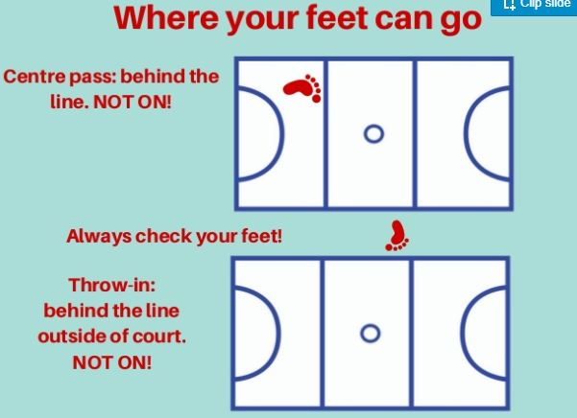

Slide 10
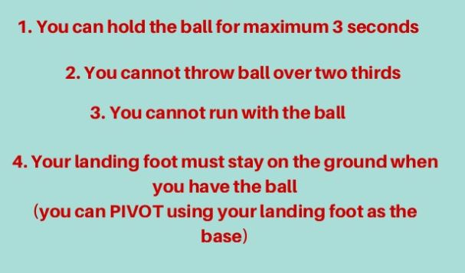
Throwing the ball

Slide 11
WHERE CAN I GO
GA
GD
GK
C
GS
WD
WA

Slide 12
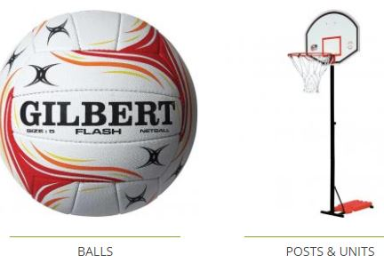
Equipment's
These include items such as netball bibs, ball bags, netball nets, floor tape, netball sets, netball coaching equipment, needle adapters and, of course, netball starter packs. Netball Goal stands for the gym, games hall, playground or garden are also available.

Slide 13
Federation
International Netball Federation
1960

Slide 15
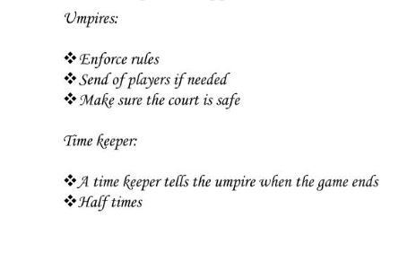

Slide 16
THANKS

